Slide 1
Capabilities
Metal Alloy and Rare Earth Alloy Manufacture
Inert Atmosphere Grinding
Atomizing
Vacuum Induction Melting
Vacuum Annealing
Hydriding

Slide 2
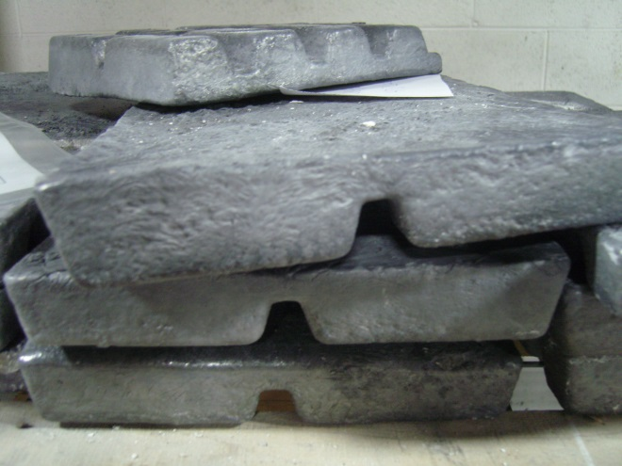
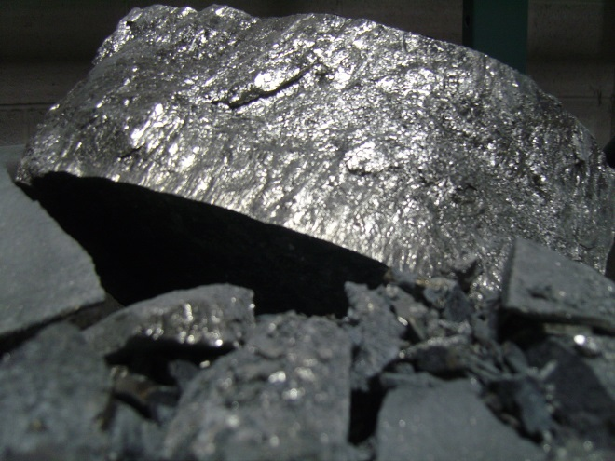
Metal Alloys
Ingots and Powder
Hydrogen Storage
Magnets
Batteries
Additive Materials
CoAlTi, AlSc, NiCa,NiMH, AB5

Slide 3
History
2014 Eutectix acquired GWTI
2012 BASF acquires OBC
2009 SB LiMotive acquires Cobasys
2007 GWMG acquired Ovonic Materials facilities from ECD
2004 Cobasys forms
2000 Chevron – Texaco buys GM interest in GM Ovonic forms JV with ECD Ovonics called Texaco Ovonic Battery Systems & adds TO Hydrogen Systems and TO Fuel Cell Company
1999 Baotou Steel RE Hi-Tech forms JV to manufacture NiMH
1998 Sanyo buys 3% stake in GM Ovonic
1996 Ni(OH)₂ manufacture begins – Honda buys 2% stake
1994 GM Ovonic JV for EV1
1985 ECD purchases ANR share of OBC
1982 ECD and ANR form OBC as JV
1978 ARCO funds R&D in hydrogen storage & PV
Notes:
Texaco Ovonic Battery Systems, and Cobasys, 2000[edit]
In October 2000, Texaco Inc. bought GM's 60% share in GM Ovonics Battery Systems, adding to their existing 20% share in the company,[17] and restructured the joint venture as a 50-50 partnership with ECD Ovonics, renamed Texaco Ovonic Battery Systems LLC.[18][19] Less than a week later, Texaco and Chevron Corporation announced a merger plan,[20] which was completed a year as they became ChevronTexaco Corporation.[21]
In 2004 this joint venture was renamed Cobasys LLC.[22]
In addition to holding a 50% share of Cobasys, Chevron holds a 19.99% interest in ECD Ovonics.[23] Chevron maintains veto power over any sale or licensing of Cobasys' NiMH technology.[24] In addition, Chevron maintains the right to seize all of Cobasys' intellectual property rights in the event that ECD Ovonics does not fulfill its contractual obligations.[24] On September 10, 2007, Chevron filed a legal claim that ECD Ovonics has not fulfilled its obligations. ECD Ovonics disputes this claim.[25]
Two other 50/50 joint ventures between Texaco and EVD Ovonics were created shortly before and after Texaco's acquisition of GM's shares in what became Cobasys. One focused on regenerative fuel cell technology, the other on metal hydride hydrogen technology.
Texaco Ovonic Fuel Cell Company, LLC[edit]
In September 2000, Texaco Ovonic Fuel Cell Company, LLC was formed as a 50/50 joint venture between ECD Ovonics and Texaco Energy Systems, Inc. to develop and market Ovonic regenerative fuel cell technology.[26] It was later renamed ChevronTexaco Ovonic Fuel Cell Company.[27] In June 2003, ECD acquired Texaco Energy Systems' share for $1.00, effective December 31, 2002, and 100% ownership was assumed by ECD. The name was changed to Ovonic Fuel Cell Company LLC.[28]
Texaco Ovonic Hydrogen Systems, LLC[edit]
In October 2000, Texaco Ovonic Hydrogen Systems, LLC was formed as a 50/50 joint venture between ECD Ovonics and Texaco Energy Systems, Inc. to develop and market ECD's metal hydride hydrogen technology.[29] It was later renamed ChevronTexaco Ovonic Hydrogen Systems.[27] In December 2004, ChevronTexaco's share in the venture was traded to ECD Ovonic in a deal that granted Cobasys an expansion of their NiMH battery technology licenses given by ECD Ovonics.[30] The now wholly owned subsidiary of ECD Ovonics was renamed Ovonic Hydrogen Systems LLC.[31]

Slide 4
Facilities
Two 12,000 square foot buildings
1864 and 1826 Northwood Drive

Slide 5
Major Equipment
Two PVT vacuum induction melting chambers (1,000 lb. capacity, 40 microns; semi-continuous melting)
Notes:
1864 Northwood Drive

Slide 6
Major Equipment
Three AVS vacuum hydriders (4,500 lb. capacity, up to 550 C and 25 PSI)

Slide 7
Major Equipment
Two inert atmosphere Vortex grind systems 1M lb./yr. capacity (Ar, N; 0.5% O2 limit, 650 lb. capacity to -400 mesh using high speed rotor with impact blocks)
Two explosion-proofed grind rooms w/ dedicated bag-house. Annual output combined ~1M lbs. moderately friable w/ a density 7 - 8 g/cm3 ).

Slide 8
Major Equipment
Heat Source Vacuum annealer (2400 lb. capacity, carbon heating elements, 1225 C upper limit; working pressure to 10 (-6) micron)

Slide 9
Major Equipment
NEVA Vacuum Atomizer w/ 3 Kg VIM capacity; 1700 C capability
AVS VIM melting chamber (500 lb. capacity) w/:
Schutte Buffalo Hammermill System (200 lb. capacity, 2000 RPM w/ oxygen monitoring system)
housed inside dedicated explosion-proofed room
Notes:
1826 Northwood Drive

Slide 10
Major Equipment
Stokes VIM chamber with 3 Kg capacity, MG power supply, 15 Kw
Lab-sized Hydrider system with 20-PSI pressure max., 10 Kg and 20 Kg reaction vessels, 400 C max temperature
Heat Source Hydrogen Annealer with 2 Kg capacity

Slide 11
Stay in Touch
Plant
Headquarters
1864 Northwood Drive
Troy, MI 48084
T: 248-293-3200
F: 248-362-3879
323 Main Street, 2nd Floor
Chatham, NJ 07928
T: 908-707-0724
F: 877-784-8569
www.eutectix.com

